Slide 1
TEAM
M.Sc. II Year ,Applied Statistics
K. Gopi Krishna
G. Chandra Lekha
CH. Sri Lakshmi
M. Urmila
M. Jyothi
M. Divya

Slide 2

DEPARTMENT OF STATISTICS UNIVERSITY COLLEGE OF SCIENCE OSMANIA UNIVERSITY HYDERABAD – INDIA
TOPIC:
PREDICTING GROSS REVENUE OF MOVIES USING SUPERVISED ALGORITHM
(R PROGRAMMING )

Slide 3

SCOPE
Predicting the Gross revenue of the movie
Finding the Key Parameters
Fitting the best model
Dataset: downloaded from UCI repository
This dataset contains the information of 231 Hollywood movies released between the years 2014 and 2015.

Slide 4

DATASET DESCRIPTION
Genre
Ratings
Gross
Sequel
Budget
1.Conventional
features
YouTube
Twitter
Comments
Views
Likes
Dislikes
Aggregate followers
2.Social media
features

Slide 5


DATA MODELING FRAMEWORK
Business Understanding:
Business objective
Project plan
Data Understanding:
Collect ,describe and explore the data
Quality verification
Data Preparation:
Relevant variables
Data formatting
Modelling:
Model selection
Assess the model
Evaluation:
Evaluate and review the process
Deployment:
Monitor and maintain the plan
CRISP-DM
1.
2.
3.
6.
4.
5.

Slide 6
DATA ANALYTICS
What is the data telling you?
Descriptive : what's happening in my business?
Comprehensive ,accurate and live data
Effective Visualization
Diagnostic : why is it happening ?
Root cause
Isolate confounding information
Predictive : what's likely to happen ?
Consistent business strategies
Use historical data
Decisions are automated
Prescriptive : what do I need to do?
Recommendations
Prescriptive
predictive
diagnostic
descriptive
Value
Complexity

Slide 7
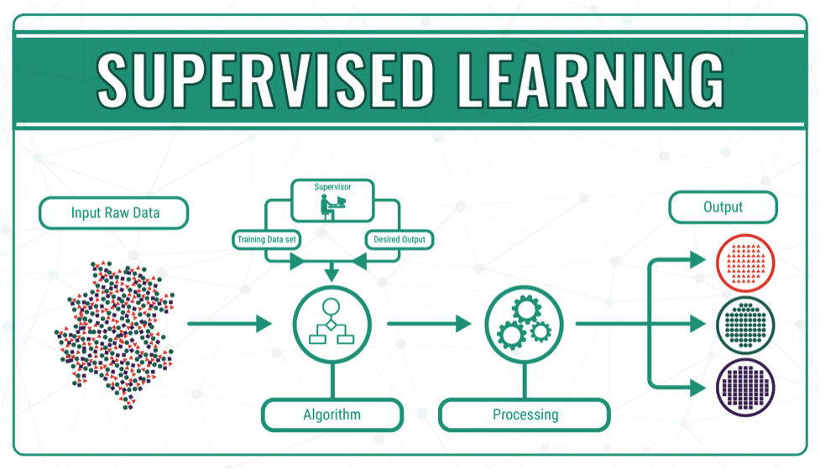
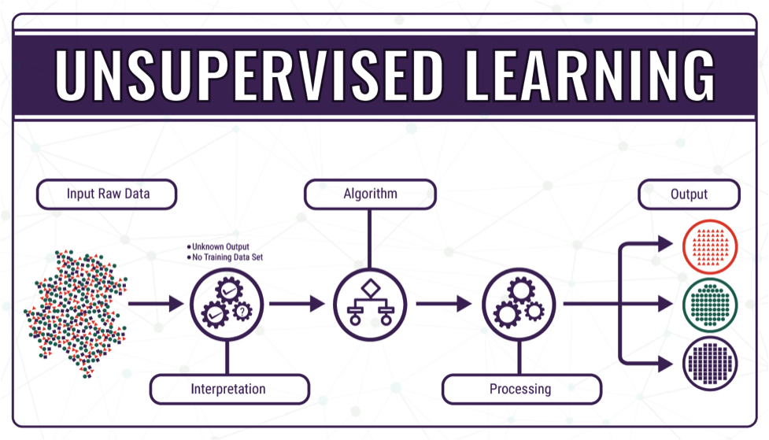
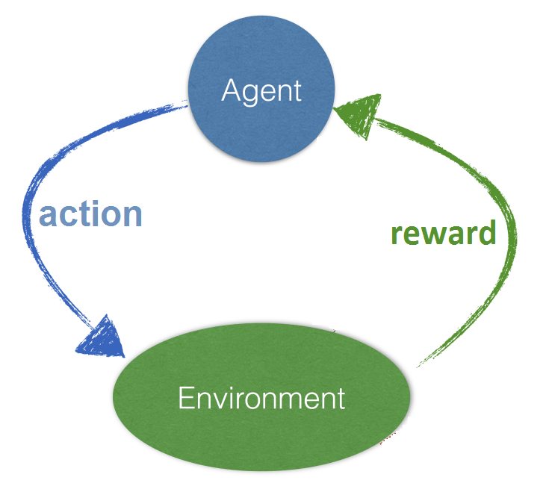
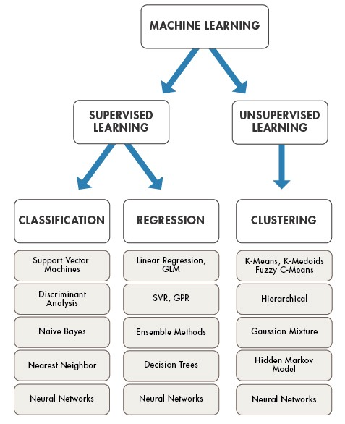
Types of machine learning
Supervised
Reinforcement
Unsupervised
Markov decision process
Self driving cars

Slide 8
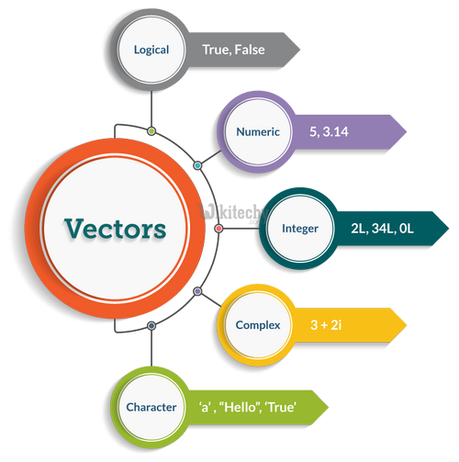
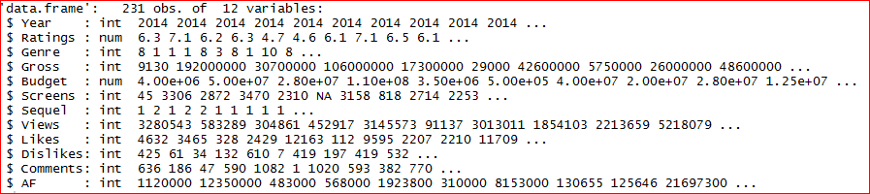
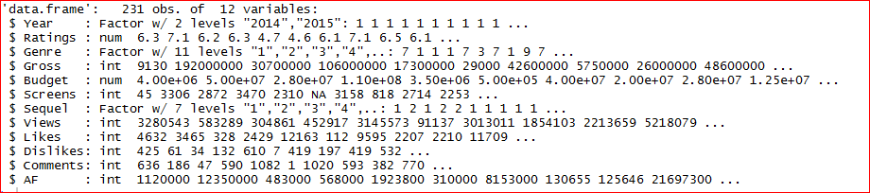
APPROACH TO THE PROBLEM
Structure of the data
After changing the data type

Slide 9
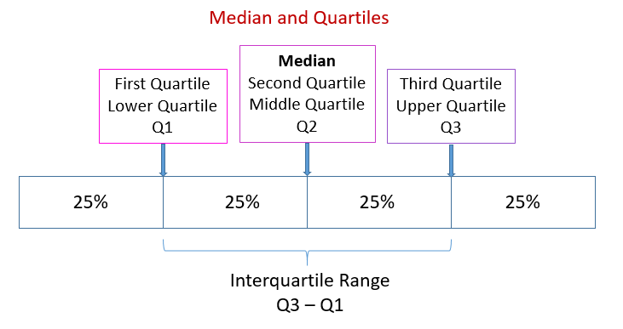
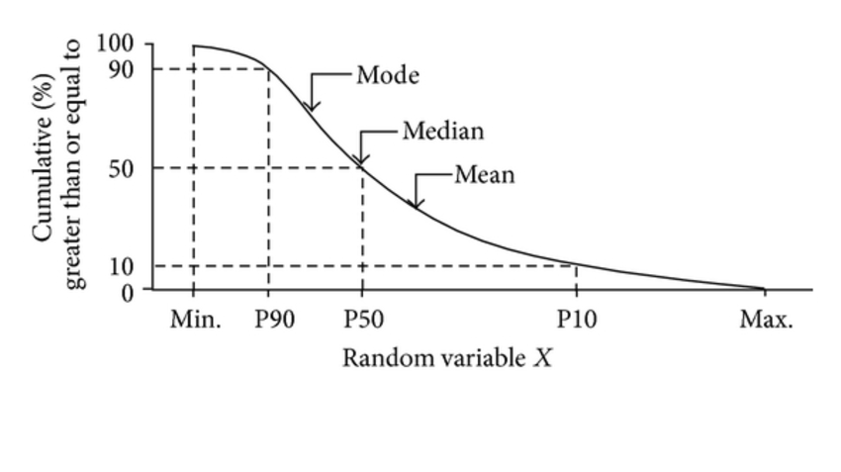
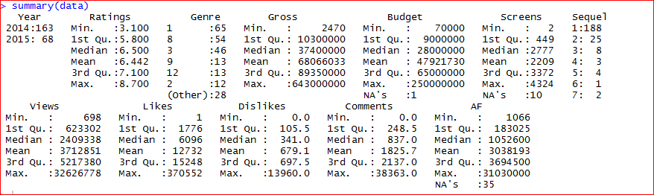
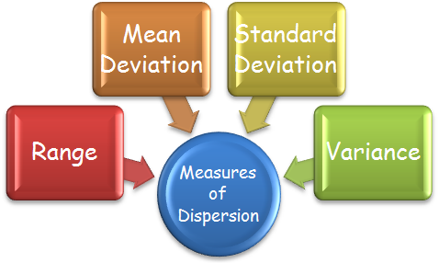
UNDERSTANDING THE DATA USING
DESCRIPTIVE STATISTICS
1. Measures of Central Tendency
3.
4.
2. Measures of Dispersion

Slide 10
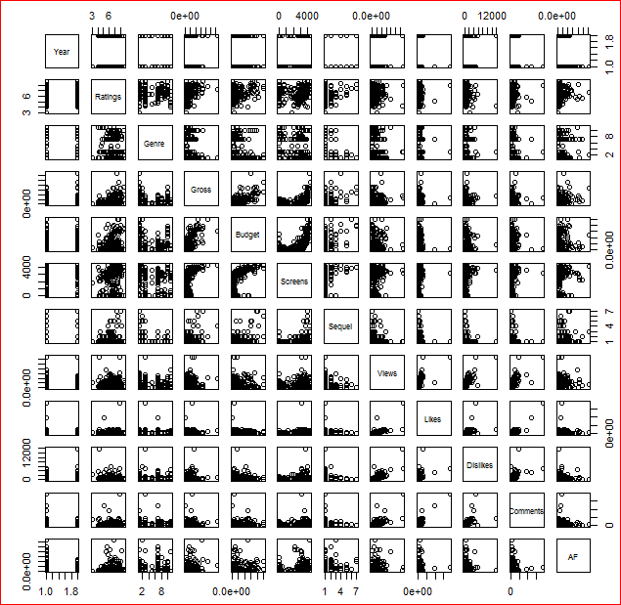
DATA VISUALIZATION
Pairs plot

Slide 11
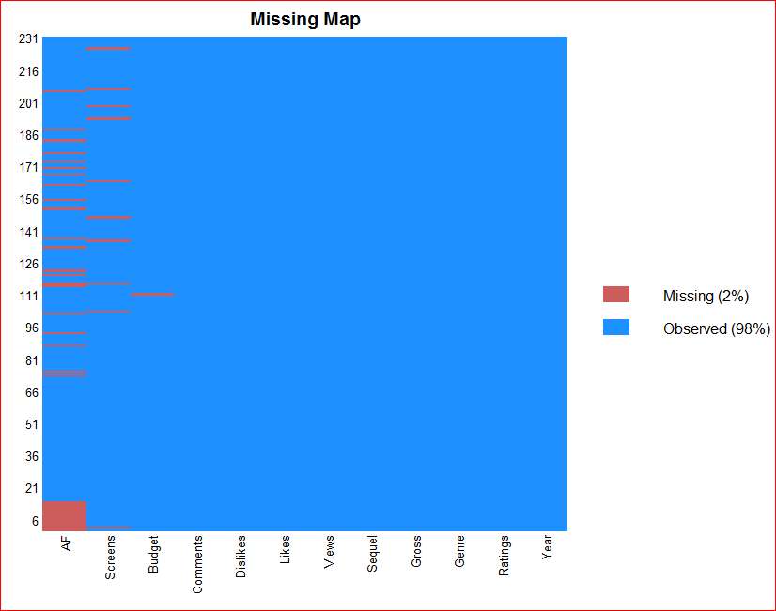
DATA VISUALIZATION
Checking for missing values
Missing map

Slide 12
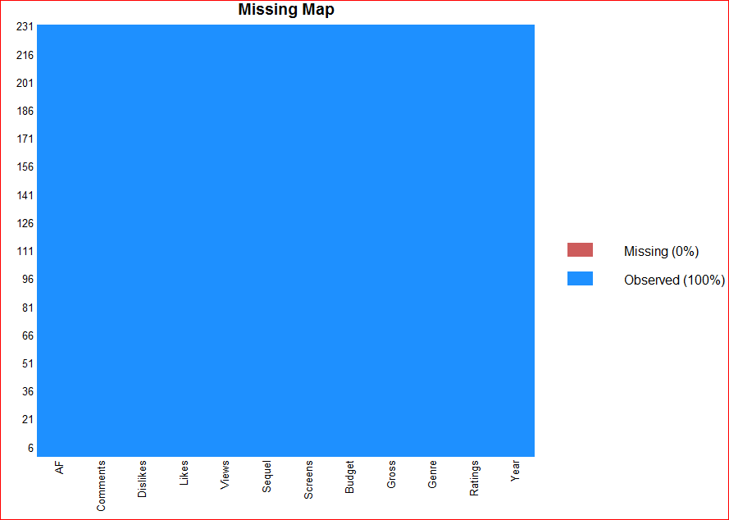
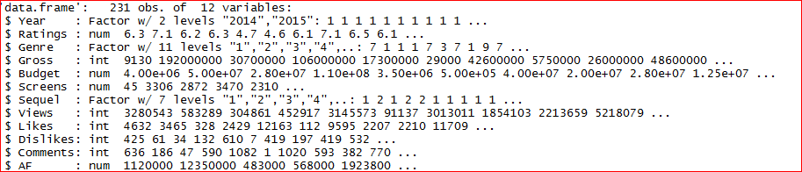
IMPUTATION OF MISSING VALUES
Missing value treatment :
1. Deletion method
2. Imputation method
i. Continuous variable: Mean /Median value
ii. Categorical variable: Mode value
3. Prediction method
Changing all the imputed variables to numeric:

Slide 13
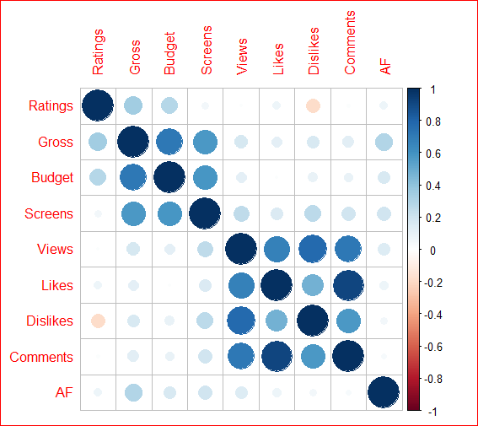
UNDERSTANDING RELATIONSHIPS
BETWEEN VARIABLES
Correlation plot :
Continuous vs Continuous
Relationship between variables
Circle size =strength of relation
Colour= direction of relationship

Slide 14
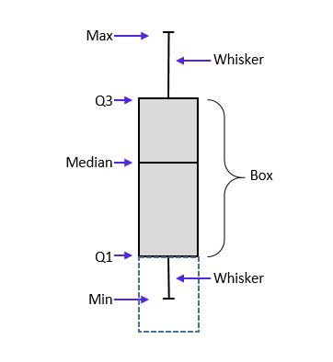
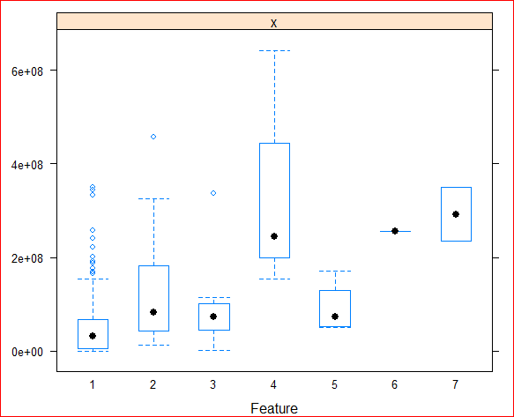
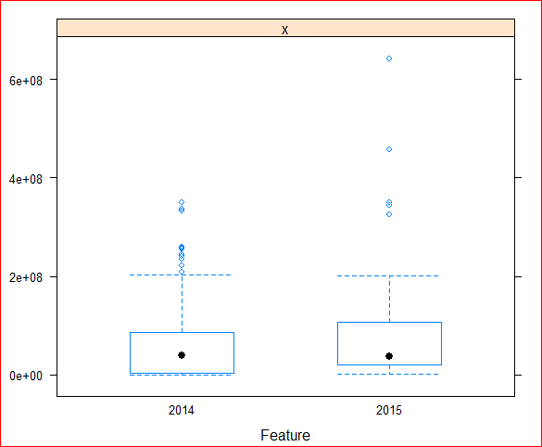
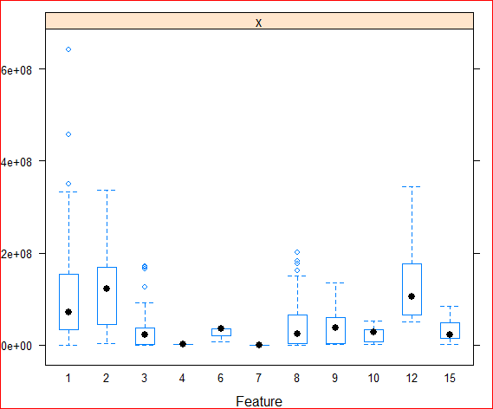
UNDERSTANDING RELATIONSHIPS
BETWEEN VARIABLES
Feature plot :
Categorical vs Continuous
1. Sequel vs Gross
2. Year vs Gross
3. Genre vs Gross

Slide 15
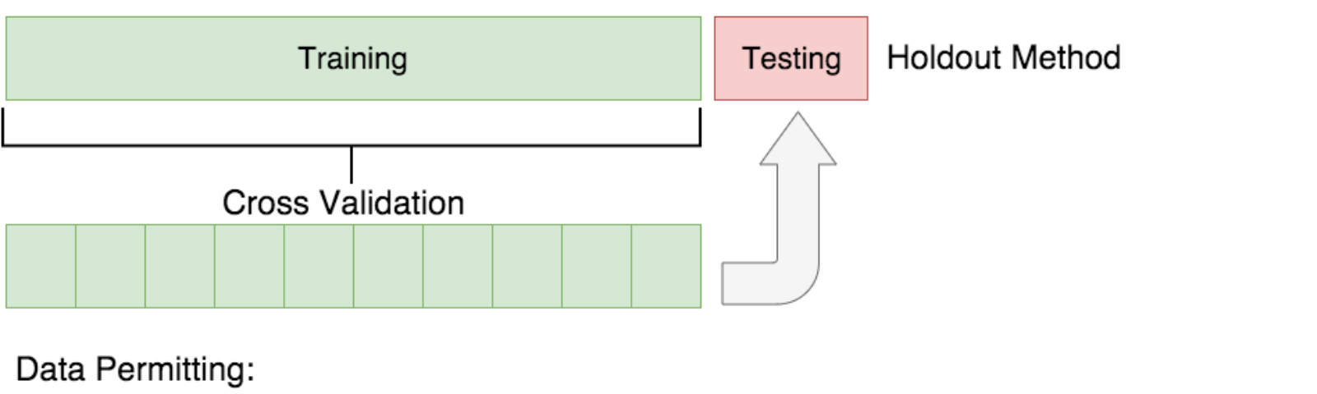
CROSS VALIDATION
Evaluating the generalization power of the model on unseen data is often referred as CROSS VALIDATION.
Two types of cross validation are:
1. Holdout Cross validation :
Dataset : Split into Train and Test randomly
Ideally we use 70-30 or 80-20 percentages
Disadvantage : may lead to higher Bias

Slide 16
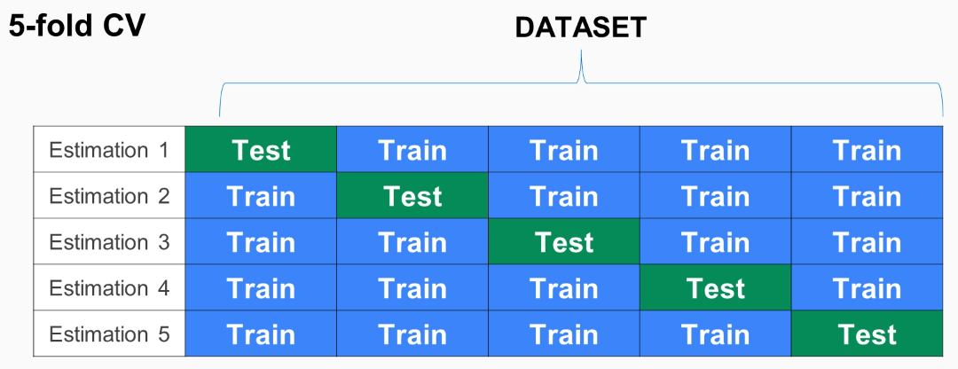
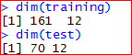
CROSS VALIDATION
for example if k=5
2. K-fold cross validation:
Randomly split into K folds
Build a model for(k-1) of the dataset
Check the effectiveness for Kth fold
Record the error for each predictions
Repeat until K folds has served as test set
Split the given data by considering 10 folds validation into train and test in proportion of 70 and 30 respectively.

Slide 17
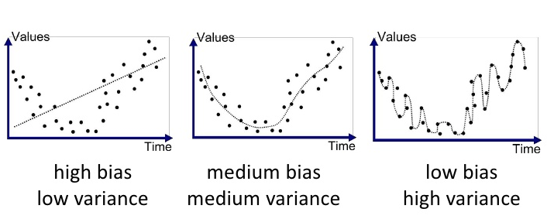
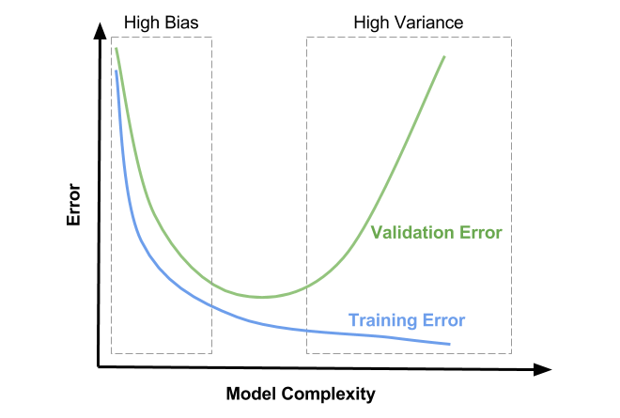
CROSS VALIDATION
ccccccccccc
Under fitting
Balanced fit
Over fitting
Trade off
To solve under fitting:
Increase more meaningful features
Increase model complexity
To solve overfitting:
Reduce number of features
Regularization methods
Dimensionality reduction
Bias Variance Trade off
Find right/good balance
Algorithm , more complex and less complex at the same time is not possible.

Slide 18
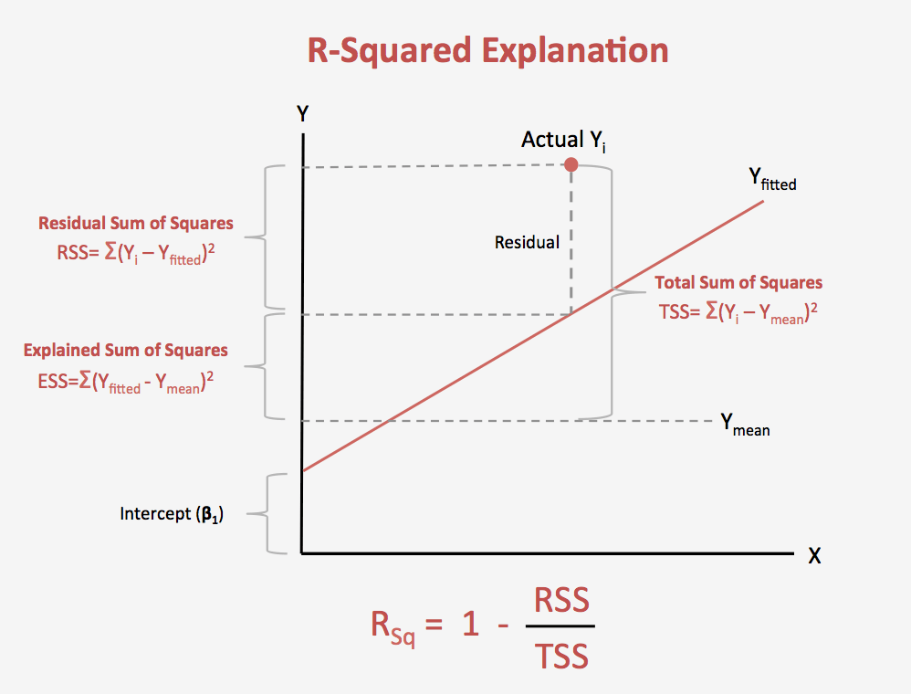
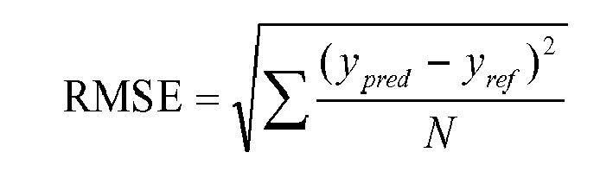
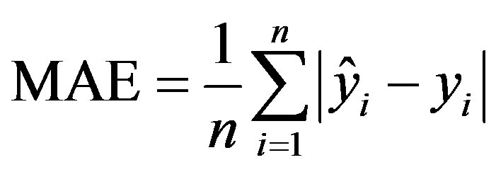
MODEL EVALUATION
In Regression based problems:
Coefficient of Determination (R-Square)
Root Mean Square Error (RMSE)
Mean Absolute Error(MAE)

Slide 19
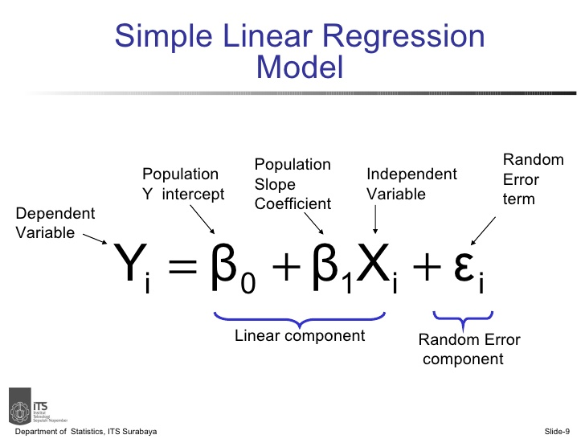
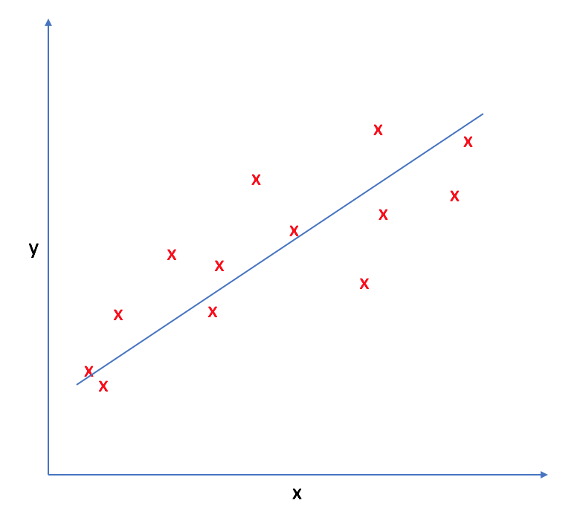
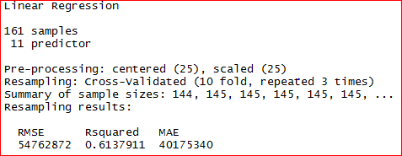
RUNNING PIPELINE USING
K-FOLD VALIDATION
We considered 10 folds for validating the Train data set and run the techniques in pipeline to choose the best algorithm.
Linear Regression, GLM, Decision Tree, k-NN, SVM and Random Forest as part of the pipeline.
Linear Regression :
Linear relationship
Least Square Estimation method
Coefficient of Determination(R-square)
Function : lm()

Slide 20
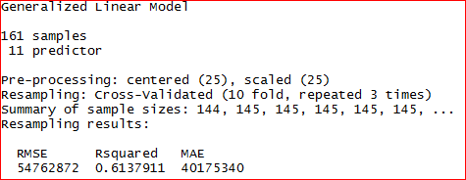
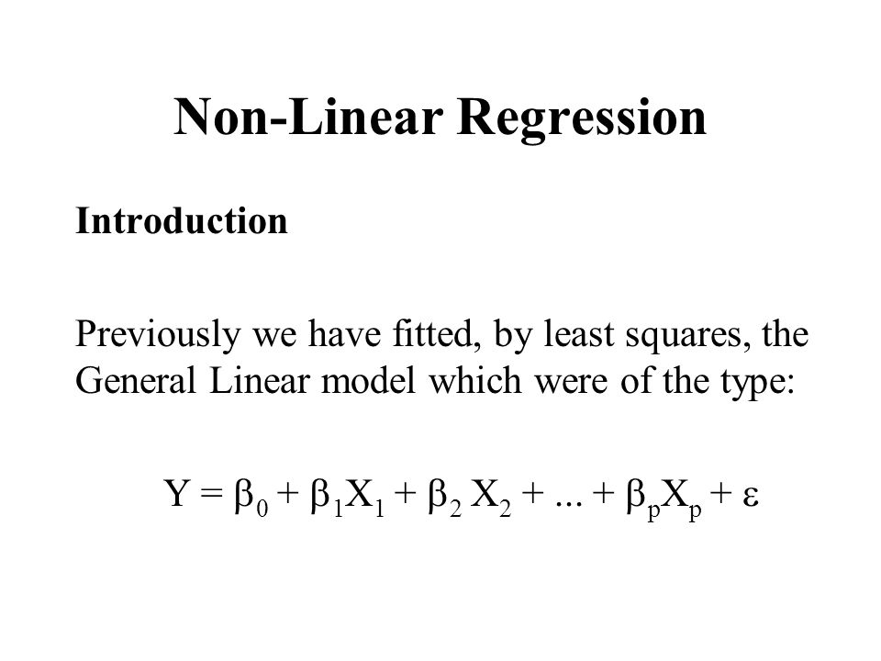
RUNNING PIPELINE
2. Generalised Linear Regression :
Linear relationship
Least Square Estimation method
Coefficient of Determination(R-square)
Function : glm()

Slide 21
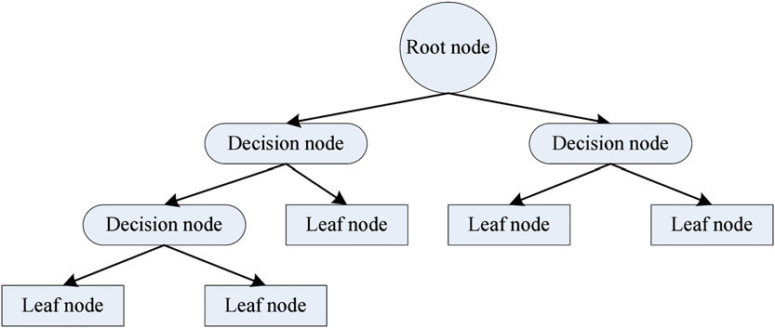
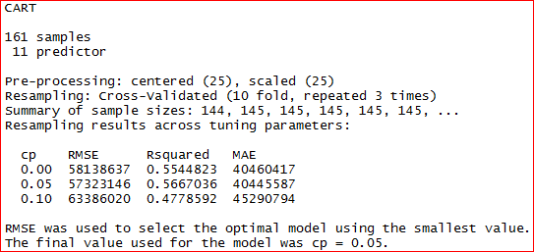
RUNNING PIPELINE
3. Decision trees :
Set of decisions
Rule based induction
Function: rpart()

Slide 22
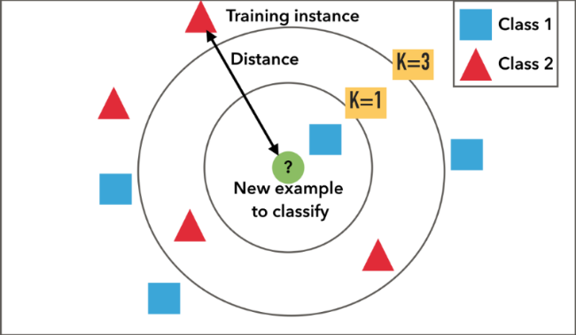
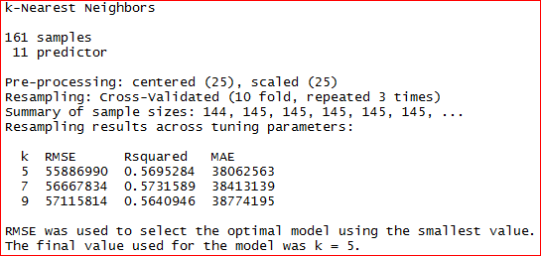
RUNNING PIPELINE
4. K-nearest neighbours
Feature similarity
Data should be normalised
Distance
Regression (average)
Function : knn()

Slide 23
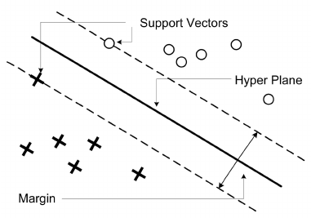
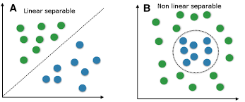
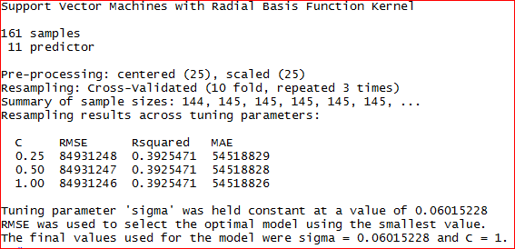
RUNNING PIPELINE
5. Support Vector Machines:
Hyperplane between data of classes
S.V maximize the margin optimal hyperplane
Function: svmRadial()

Slide 24
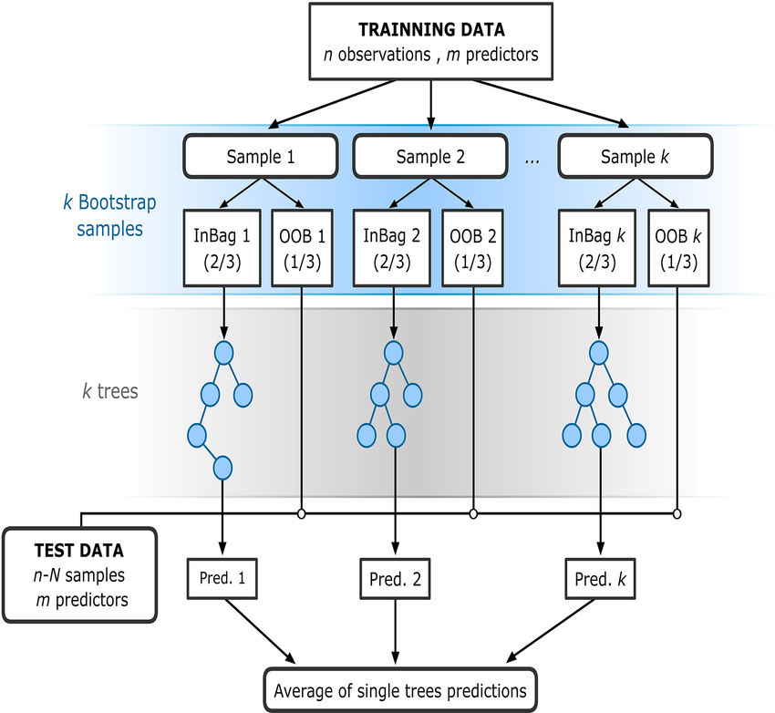
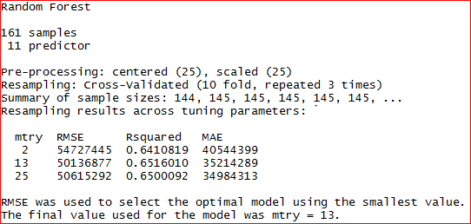
RUNNING PIPELINE
6. Random Forest:
Ensemble ML method
Combining group of weak models to form a powerful model
Feature importance
Parameter Tuning: Ntree ,mtry , node size
Function: rf()

Slide 25
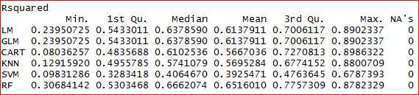
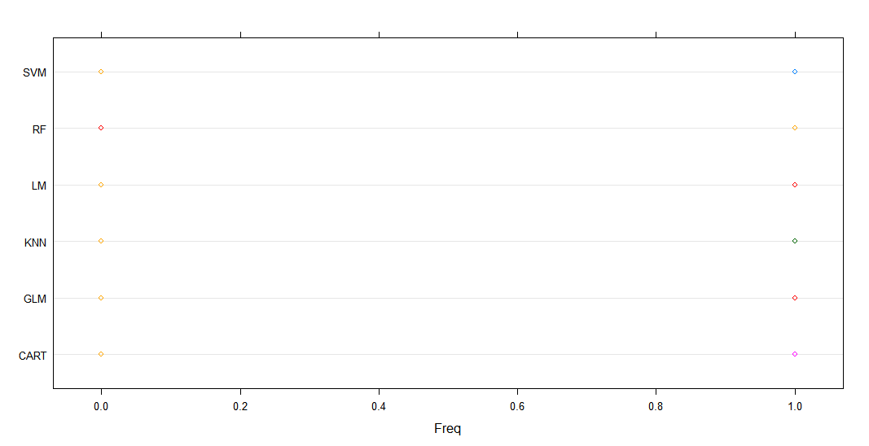
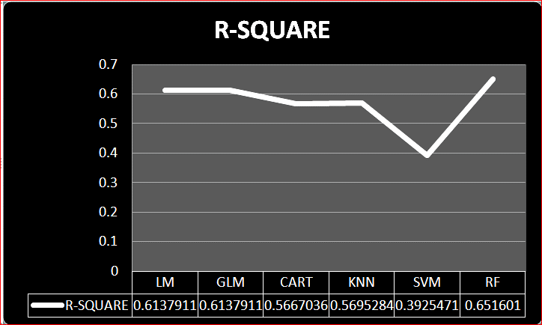
COMPARISON OF ALGORITHMS

Slide 26
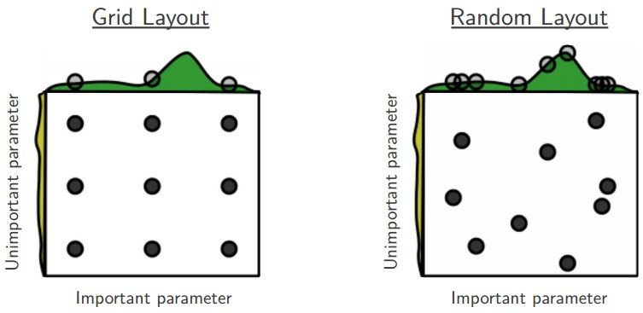
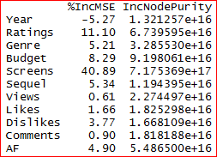
HYPER PARAMETERS
Hyper Parameter Tuning :
1. Grid search
2. Random search
Feature Importance
We run the Random Forest using grid search and obtained the key hyperparameters
From this table, we can observe that Screens, Ratings, Budget, Sequel and Genre are the variables which have more importance than other variables in predicting Gross

Slide 27
OUTPUT

Slide 28
CONCLUSIONS
Multiple Linear Regression(GLM) is the best model based on R-square value.
Using Random Forest ,we have identified the key variables as Budget, Ratings, Genre, Sequel and Screens which we have used to predict the GROSS.
Hence, we have applied the Multiple Linear Regression model for these key variables and predicted the Gross in train and test data and computed the R-Square value.
R-SQUARE FOR TRAIN DATA IS - 67.38 ~67 %
R-SQUARE FOR TEST DATA IS: - 73.84 ~74%
Since, the accuracy of train and test data are more or less similar. Hence, the model is a Generalized model, so we can use this model to predict the future data.

Slide 29
ACKNOWLEDGEMENTS
We deem it a great pleasure to express our deep sense of gratitude and indebtedness to our research supervisor T.SANDHYA, Statistics department, University College of Science, Osmania University
We also express our sincere and heartfelt thanks to Prof. C. JAYALAKSHMI, Head of the Department, Department of Statistics, Osmania University
It is indeed with great pleasure we record our thanks to Dr. G. JAYASREE, Chairperson, Board of studies, Department of Statistics, Osmania University
We also thank Dr.N.Ch.BHATRACHARYULU, Dr.K.VANI, Dr.S.A.JYOTHI RANI, Dr.G.SIRISHA, Mrs.J.L.PADMA SHREE, for their encouragement
We would like to express our deepest gratitude to Dr M. VENUGOPALA RAO, BALA KARTHIK
We thank all Non-Teaching staff of Department of Statistics
We are thankful to the Osmania University

Slide 30


Slide 31
The End

